Slide 1
MANAGING HEALTHCARE SPENDING: THE CASE OF SPAIN
Prof. Massimo Cermelli
PhD Lecturer & Researcher
University of Deusto – Deusto Business School

Slide 2
Index
A regional/value-based healthcare
Millennium challenges
New technologies
Demand of health services
Emerging diseases
How this challenges can be faced

Slide 3
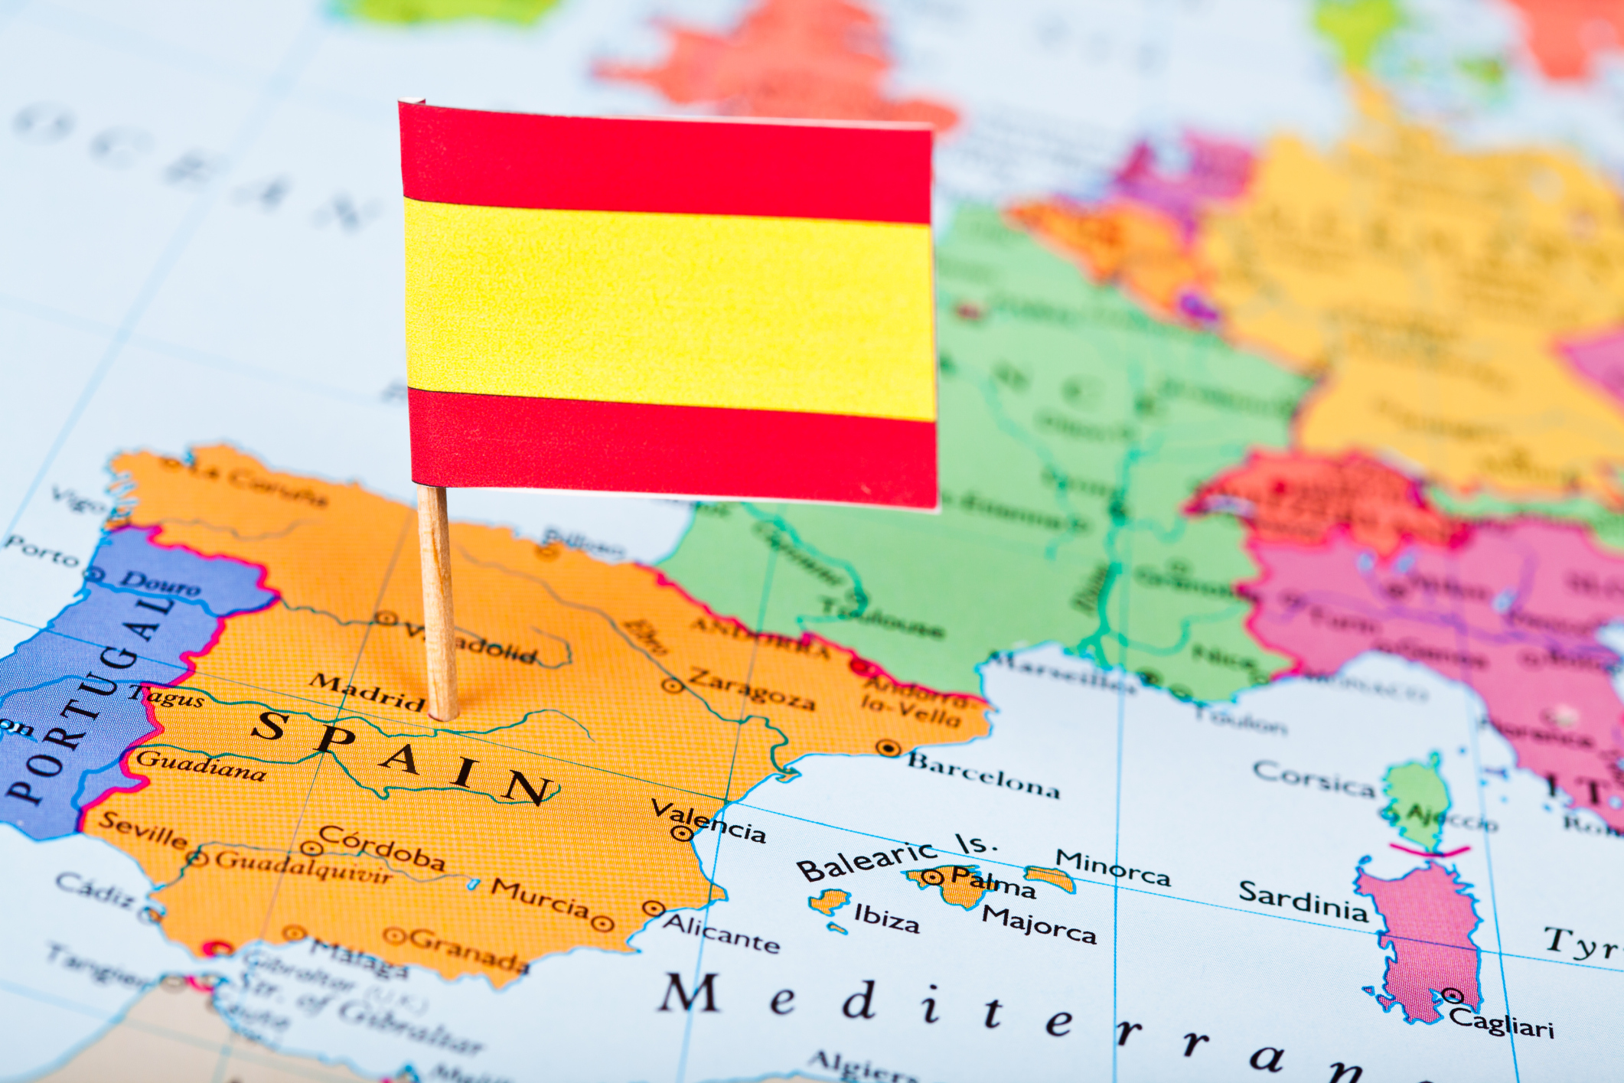
A regional/value-based healthcare

Slide 4
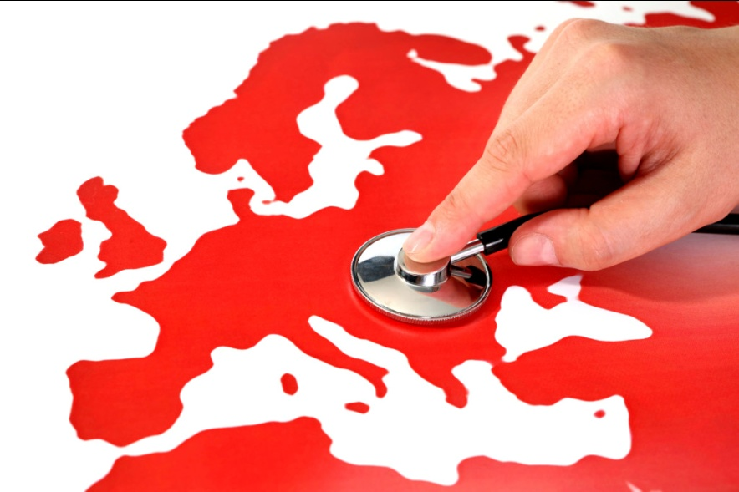
Economic Environment
The main characteristics of the crisis in Spain:
High unemployment rate (21%)
Great deficit (5%)
GDP growth +3,2 (2015) +2,4% (2014)
Measures implemented:
Salary reduction (10% 2015)
Cuts:
Education: €3 bill.
Health System : € 7 bill (2012-2013)
€ 10 bill (2009-2013)

Slide 5
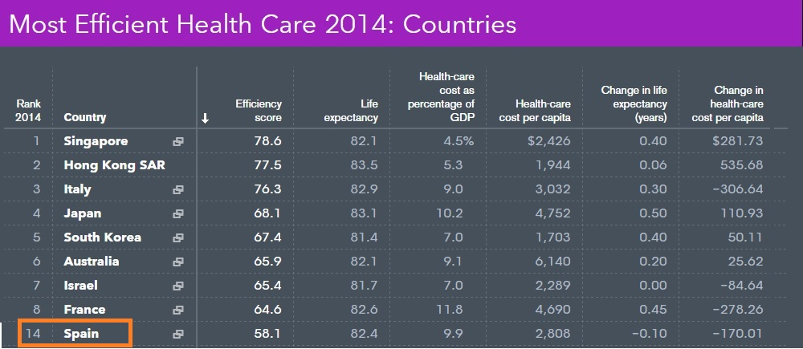
Spanish Health-care System in the world: efficiency rates
Source: Bloomberg (January 2016)

Slide 6
Expenditure in Health-care System Average current health expenditure as a share of GDP, 2005-2013
From 9,6% (2010) to 8,5% (2013) on GDP
Source: OECD Health at glance 2015

Slide 7
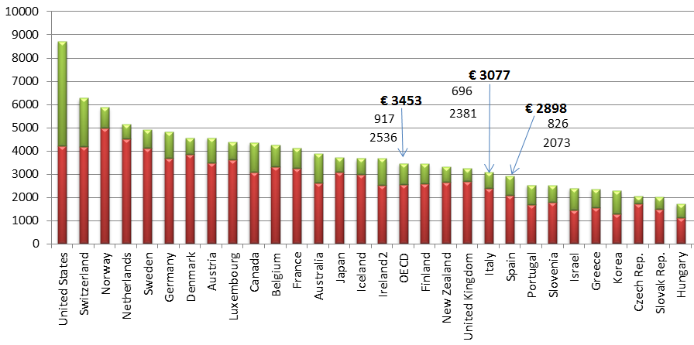
Expenditure in Health-care System
SPAIN
Source: OECD Health at glance 2015

Slide 8
Expenditure in Health-care System
Gen.Gov + Soc. Sec. = 71,5%
Private = 28,5%
77,4 + 22,6 (Italy)
Source: OECD Health at glance 2015

Slide 9
Expenditure in Health-care System (Pharmaceutical expenditure)
Source: OECD Health at glance 2015
Notes:
In this graph, we can see the expenditure on Health-care systems per country. Spain, with an investment of 2,671€ per person, it is situated below the average in the OECD, despite the fact that it is among the most efficient one in the world as we have just seen before.
Then, we can conclude that, although Health Systems have to be well-funded, there is room to improve the quality of service with improvements in efficiency rates. And, in this speech, that’s what we would like to show it to you.

Slide 10
Spanish regional model (decentralised model)
Source: Spain’s Ministry of Health, Social Services and Equality (2015)

Slide 11
Distribution of expenses
Source: Spain’s Ministry of Health, Social Services and Equality (2015)
The total health expenses account for 8,5 % of the GDP

Slide 12
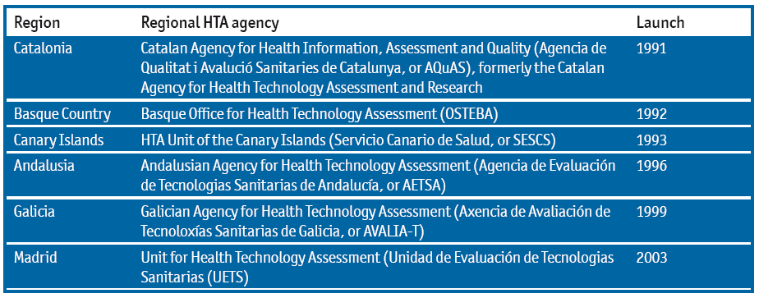
Regional Health Technology Assessment (RHTA)
Source: The Economist Intelligence Unit 2015
Ministry sets pharmaceutical policy while Regions run their own health budgets
Regional responsibility for 30% - 40% of regional governments’total annual budget
Mixing Flexibility for innovation in the regions and value-based mesaures

Slide 13
Health Technology Assessment (HTA)
National Level: common benefit package for devices and treatments (exc. pharmaceuticals)¹
National Level: Pharmaceuticals
Regional Level
1 - cost, efficacy, efficiency, effectiveness, safety and health care utility of the technology
2 - The Ministries of Health, Economy (Ministerio de Economia y Hacienda) and Industry (Ministerio de Industria, Turismo y Comercio) propose the prices for pharmaceuticals to the the national government cabinet (Consejo de Ministros) that has the final responsibility for setting pharmaceutical prices. The Interministerial Comission for Pharmaceutical Prices (Comisión Interministerial de Precios de los Medicamentos) includes representation of the Ministries of Health, Ecomony (Ministerio de Economia y Hacienda) and Industry (Ministerio de Industria, Turismo y Comercio). The Comission proposes the prices for pharmaceuticals to the the national government cabinet (Consejo de Ministros) that has the final responsibility for setting pharmaceutical prices. The Spanish Medicine and Health Products Agency (Agencia Española de Medicamentos y Productos Sanitarios) prepares a report about the therapeutic utility of pharmaceuticals that must be considered by the Comission when proposing pharmaceuical prices.
The Agency is in the process of establishing a HTA system for evaluation of pharmaceuticals. The Ministry of Health has the responsibility for deciding reimbursement of pharmaceuticals by the National Health Service. According to the Law 29/2006, the reimbursement decision must consider the following: a) severity, duration and sequels of the diseases for which the drug is indicated; b) therapeutic and social utility of the drug; c) rationalization of public drug expenditures; d) alternatives for the indications targeted by the drug; and e) the novelty of the drug.
3 - The decision-making process at the regional level is decided by each region. The participation of the HTA organizations in the decision-making process is also regulated at the level of the Autonomous Community. The regional organizations collaborate with the national agency and support the decision-making process at the regional level.

Slide 14
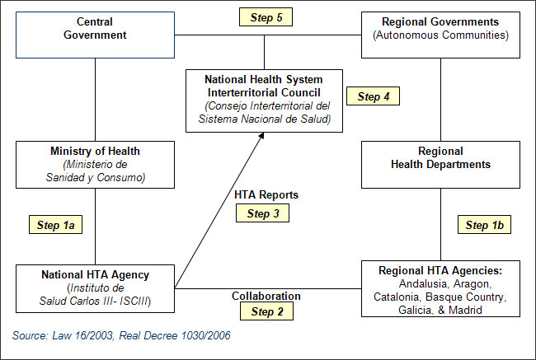
Health Technology Assessment (HTA)

Slide 15
Pricing Approval Process
After market authorization, the manufacturer first need to go through some administrative tasks with the AEMPS (Agencia Española de Medicamentos y Productos Sanitarios), including getting a national product code, before the Directorate of Pharmaceutical and Health Products DGFPS initiates the procedure for pricing and reimbursement.
Each company is free to submit as much documentation as considered necessary to support a positive decision; among these documents there is just a compulsory one “Price application” where the company establishes the desired price as well as the following information:
Cost per day compared with equivalent products in Spain
Price of the product in other EU countries
Sales forecast
The overall cost of R&D, production cost, etc.
New product prices are published in the Official Journal (Boletín Oficial del Estado) although are effective as soon as officially communicated to the company.
It should be mentioned that the regions have a degree of freedom to impose their own pharmaceutical price caps or cost-containment targets and free pricing is allowed for new prescription products that do not enter the reimbursement system.
According to the Directive 89/105/EEG, the pricing & reimbursement process should not take longer than 180 days (431 days in 2013)
The inter-ministerial pricing committee (Comisión Interministerial de Precios de los Medicamentos, or CIPM)—which includes officials from the Ministry of Health, the Ministry of Economy and Finance and the Ministry of Industry, Tourism and Trade—deals with reimbursement and pricing, and sets maximum ex-factory prices for every medicine, including generics. (COST – EFFICACY – SAFETY) / (not consistently evaluate COST-EFFECTIVENESS or BUDGET IMPACTS).
Since March 2012 the regions have been members of the pricing committee, with two regional representatives rotating every six months.

Slide 16
Regional Health Technology Assessment (RHTA)
OSTEBA AETSA AVALIA-T: undertake some horizon-scanning of emerging tecnologies
GENESIS supports AEMPS (Agencia Española de Medicamentos y Productos Sanitarios – hospitals from 11 autonomous regions ( coordinated by Aragón, Andalusia, Catalonia, Navarra and Basque Country)
Open Data – Participation projects

Slide 17
MILLENIUM CHALLENGES
THE NEW CONTEXT OF OUR NATIONAL HEALTH SYSTEM
Notes:
THESE CHALLENGES EXPLAIN THE NEW CONTEXT OF OUR NATIONAL HEALTH SYSTEM

Slide 18
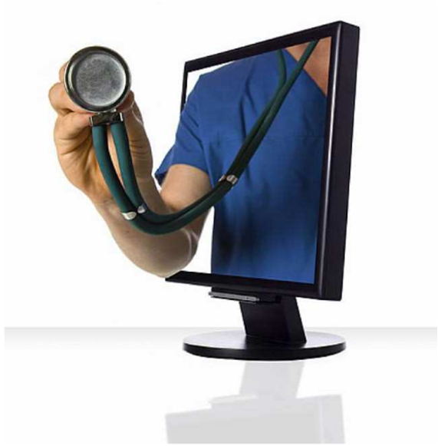
1. Development and spread of new technologies in health
Electronic health card
E-prescribing
Analysis of the human genome
Online health services
Exchange appropiate medical information
Training programs
Telemedicine
Universal acces of patients medical records
Active
Responsible
Autonomous
Notes:
a) The development and spread of new technologies in health
The phenomenon known as eHealth, includes the development of information and communications technology applications (TIC), especially the Internet, in the field of health.
EFFECTS ON THE HEALTH SYSTEM Electronic health cards, e-prescribing, advances on genetics (analysis of the human genome), online delivery of health services.
EFFECTS ON HEALTH PROFFESIONALS
Technological applications and information systems enable doctors and other professionals exchange appropriate health information, to have access to training, providing services across geographical boundaries (development of telemedicine) as well as universal access to patients' medical records, develop assistance prevention and health promotion programs.
EFFECTS ON PATIENTS:
In recent years there has been an increasing autonomy and responsibility of citizens regarding their health. Consultation of health information available on the Internet could enable patients to be better informed, encouraging their participation (active), providing a more appropriate use of health services (responsible) and promoting adherence to treatment (autonomous).

Slide 19
2.Demand of health services
Aging and life expectancy
Chronicity
Unhealthy habits
Immigration
Drug spending, inflation rates and inefficiency of the system
Notes:
Ageing, a constant rise in demand for healthcare, rapid and continuous technological and pharmacological innovation and a growing pressure on financial resources are some of the reasons for needing renewal in our health system.

Slide 20
Aging and life expectancy
Europe forecasts : In 2030, 24% of the population will be over 65
Spain forecasts: In 2050, 31% of the population will be over 65.
Source: National Institute of Statistics (INE)
Notes:
Over the last 30 years, the elderly population of developed countries has shown an unprecedented increase. This process has raised alarm about the future affordability of health care systems.
Europe forecasts suggest that population over 65 will constitute 24% of the population in 2030.
In Spain, it is expected that the population over 65 will be 30.85% in 2050.
The consequences of this demographic transition have been:
The worsening of the dependency ratio (number of persons aged 65 years and over, compared to those between 15 and 64) that may exceed 50% in 2050.
The increased of sanitary expenditure attributable to the increase in the population over 65 and with poorer health.
(Health expenditure of the elderly is, in relative terms, much higher than the rest, therefore, aging is a clear source for the future financing of health services stress)

Slide 21
Chronicity
Chronic patients account for 80% of primary care consultations, 60% of hospital admissions and 70% of health expenditure
Source: National Institute of Statistics (INE)
Notes:
In Spain the increase of life expectancy, improvements in public health and health care, and the adoption of certain lifestyles, have meant that, nowadays, the dominant epidemiological pattern is represented by chronic diseases.
Such diseases are of :
Long duration
Slow progression
Entail a limitation on the quality of life
Cause premature mortality
Cause significant economic impact on families, communities and society
Chronic patients account for 80% of primary care consultations, 60% of hospital admissions and 70% of health expenditure, and their number and complexity is ever increasing.
The provision of services is fragmented and chronic patients have special requirements in this respect, since the care they need tends to involves the participation of several centres, a range of specialists, many different drugs, etc. Therefore, the transformation to a better prepared model better for the prevention and management of chronic health conditions is essential for the sustainability of our Health System.

Slide 22
Unhealthy habits
Risk factors:
Smoking
Alcoholism
Obesity
Sedentary lifestyle
Responsible for almost 80% of coronary heart and stroke.
Notes:
Risk factors such as smoking, alcoholism, obesity or sedentary lifestyle are named as sources of chronic diseases.
It is estimated that these risk factors are responsible for about 80% of coronary heart diseases and stroke.

Slide 23
Immigration
This phenomenon has caused controversy
Real issue: the little tradition of immigrants in health care system
Solution: proper use and rational distribution of health available resources
Notes:
Since 1999, the evolution of the foreign population in our country has experienced remarkable growth.
The impact of this phenomenon on the National Health System is controversial: For some it has negative effects, assuming that this situation leads to an increase in healthcare spending constituting a burden on health services.
But the real problem is the lack of tradition in health care to immigrants, determining a poor adaptation of our health care system. There is an inappropriate relationship between current resources and the volume of work that requires the care of these patients.
Overall, we can conclude that the real impact of immigration on public health is poor and that we have the necessary resources for proper care, depending on the success of proper utilization and rational distribution of the resources.
In Spain, the number of immigrants reached the 5.1M (11% of the population) in 2013.

Slide 24
Drug spending, inflation rates and inefficiency of the system
2nd major cause of the growth of health spending.
Pharmaceutical spending represents 18% - 22% of health care spending. The biggest expense is explained by increased on the consumption.
Approximately 70% of the Spanish population consumes more than a medical prescription per week.
Notes:
Regarded as the 2nd major cause of the growth of health spending.
In recent years we have witnessed a process of rising prices of new health technologies due to the rising costs of introducing innovations. This coupled with the increase in drug spending contributes to precarity of the system.
The public health system has the tendency to spend beyond the budget authorized by the regional parliaments, leading to deficit.
Pharmaceutical expenditure per capita in Spain is 40 % higher than in countries such as Belgium, Denmark, United Kingdom and Portugal and represents 18% of total health expenditure compared to 17% of the European average. But the cost of medicines is also among the lowest in Europe, suggesting a high volume of consumption. Approximately 70 % of the Spanish population consumes more than a prescription a week.

Slide 25
3. Emerging diseases
Globalizing human activities: World Population Growth Emigration, International travel World trade Climate change
Increased risk population: Ageing, immunocompromised Poverty, risk practices Health infrastructure deficit
Pathogens adaptation and change: Antibiotic resistance Expansion, new environments, reservoirs, vectors
Notes:
Emerging diseases are mainly caused by human activity and specifically the phenomenon of globalization.
The population growth, facilities and the increased in traveling and tourism, trade and exchange of goods, food, etc… have progressively increased the risk of microbial exposure worldwide.
There are also more people at risk (elderly population, immunocompromised, etc.) and also microorganisms suffer permanent adaptation and change which makes them more resistant and difficult to combat. This makes the challenge of infectious diseases remains very present.

Slide 26
HOW CAN THIS CHALLENGES BE FACED?

Slide 27
How these challenges are being faced in Basque Country
SHORT
TERM
LONG
TERM
Classic cost driven management
Proactive management
Saved funds are invested in proactive management

Slide 28
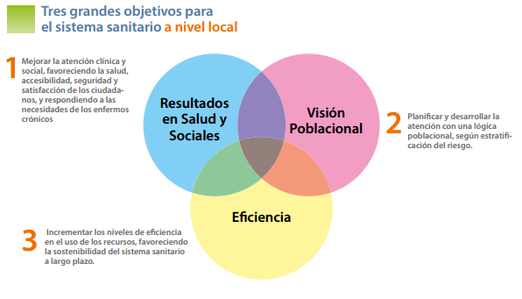
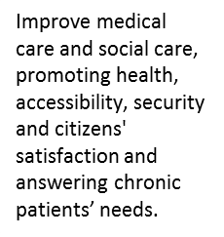
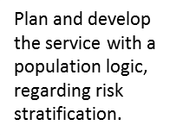
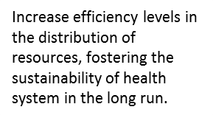
ACOs model
Accountable care organisations
How these challenges are being faced in Basque Country
Three main objectives for health management
Triple Aim Initiative (Institute for Healthcare Improvement - Cambridge Massachusetts)

Slide 29
How these challenges are being faced in Basque Country
SHORT
TERM
Classic cost driven management
1. Medicine standardization
2. Centralized warehouse
3. Service joining
Notes:
2.1medicine standardization
An example of this in Osakidetza was to standarize the dressings use for the treatment of ulcers. A protocol has been implemented so that only one type of dressings for ulcers are purchase according to an official criteria, established through an analysis in which the best dressing according to the type of ulcer was defined. This reduces the dressings used, increasing the purchasing volume and decreasing the purchasing costs. If a professional faces a situation in which a special dressing is need it will be provided, once the Corporate Nursing Department has given their acceptance.
2.2centralized warehouse
In Bilbao, biggest city in Basque Country, there is a central warehouse for the public health care. All the providers supply Osakidetza to that warehouse and then Osakidetza supplys each national health clinic. Osakidetza orders materials for all Basque Country, so that a volume discount can be achieved. However, some things are purchased directly from the clinics, because they are so specific that the other procedure will not be cost-effective.
2.3service joining
In osakidetza they take the most of all synergies, for instance, by joining services. The internal correspondence (checks, order forms or delivery slips, of invoices, pay slips or fee claims,…) and the transport of blood samples are done by the same external company. The analysis of the blood is done in the hospitals not in the clinics and through this procedure, they reduce not only transport costs but also other costs such as security, insurance, …

Slide 30
SHORT
TERM
How these challenges are being faced in Basque Country
LONG
TERM
Proactive management
1. Populations’ stratification
2. Electronic prescription
3. Integrated health organization
4. Chronicity

Slide 31
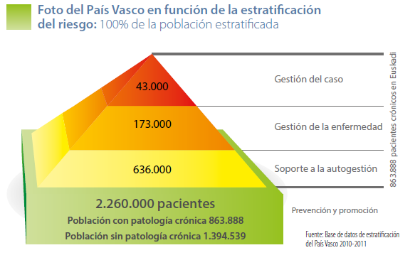
SHORT
TERM
LONG
TERM
How these challenges are being faced in Basque Country
LONG
TERM
Proactive management
1. Populations’ stratification
Chronic Patients
Case management
Notes:
Focus on population: stratification and targeting of the population: Predictive models allow populations to be stratified according to their health requirements for the following year. They offer health care organizations the opportunity to act proactively, designing specific interventions adapted to the level of need of different groups of people. The “Strategy for tackling the challenge of chronic illness in the Basque Country” proposes the use of such models. Specifically it allows to:
-plan in a microsystem level and define concrete interventions for specific groups of patients according to their needs and risk level.
-it allows to health professional to be proactive and intervene citizens before they are patients, this is, proactive medicine, according to an study done in a hospital in Basque Country, a euro invested in preventive medicine, saves 1,8€. For instance, human genome analysis constitutes a whole new field inside healthcare. By knowing the complete sequence of the DNA illness can be predicted before symptoms appear. In Osakidetza exists a genetic actuation plan that guarantees that everyone in Basque Country affected by a genetic illness or with risk of suffering or transmitting in the future has access to a center where genetic test, information and advice is given.
-the data regarding stratification is integrated in their medical history.
The prospective categorization of all the population assigned to Osakidetza was performed for the first time in 2010 using the Johns Hopkins Adjusted Clinical Groups predictive model (ACG-PM). For this purpose, already recorded information extracted from electronic health records of primary care and hospital discharge reports was used. It was first used to plan the 2012 year. From more than 860.000 Basque chronic patients were grouped and intervention plan was established for each group.

Slide 32
SHORT
TERM
How these challenges are being faced in Basque Country
LONG
TERM
Proactive management
2. Electronic prescription
Reduce adverse impacts.
Unified medication plans.
Coordination with the pharmacies.
Reduce a 60% the medicaments overlapping.
Notes:
Currently, no recipe is printed in Basque Country, everything works electronically. After visiting the doctor, the patient goes to a chemist’s shop and with his or her health card it is enough to know the drug the patient needs. With this project Osakidetza wants to achieve:
-Increase the security of the patients, avoiding adverse impacts, want also implies relevant savings in health expenditure (3.000€ for each patient with adverse impacts due to medication).
-Improve the coordination among health professionals with unified medication plans.
-Improve the coordination with the pharmacies, providing them with information so that they can service better their clients.
-Reduce a 60% the medicaments overlapping, increasing the efficiency in the use of resources.
Currently, this Project has enable health professionals to cooperate and to reduce a 67% the security incidents of patients. By 2013 Basque Country was the only territory in Spain with this mechanism fully implemented.

Slide 33
SHORT
TERM
How these challenges are being faced in Basque Country
LONG
TERM
Proactive management
3. Integrated health organization
OSABIDE GLOBAL: Unified medical history
OSAREAN: Multichannel Health Services Centre.
Notes:
Another way to take advantage of synergies is to integrate the management of the health care as much as possible. In osakidetza there are two projects oriented in this field:
OSABIDE GLOBAL: Unified medical history. It consists in a tool improve the information of the patient, but also provides new forms of attending the patient, such as no-face-to-face consultations. The information from hospital, specialist and primary care is integrated. So health professionals are coordinated, and have the latest information about the patient. This project has achieve:
No repetition of unnecessary tests, what implies economic and social saving.
It permits the exchange of data among professionals.
Optimizing specialist timetable, a key issue in the effectiveness and patient satisfaction is the waiting time for a specialist, so to reduce it, in Osakidetza they try to optimize their timetable. Making specialist not to waste their working time in what is indispensable. For instance, after a medical test, if everything is correct or the result is clear and easy to communicate to the patient, the patient will receive the notice through his or her family doctor.
OSAREAN: Multichannel Health Serivices Centre.
It consist on a non-face-to-face health care through new technologies, its mission is to facilitate to patients, relatives or professionals a non-face-to-face relationship with the health system, through different channels; phone, e-mail, videoconference, TV, web, social networks, etc. This facilitates the self-management of the patient, and gives new tools to respond to patients needs not faced before.
It has significant advantages:
-it reduces the paperwork.
-it allows reducing the uncertainty of patient in no serious illness.
-it avoids unnecessary journeys to health centers.
-It facilitates health information to the population.
-it allow to monitor chronic patients
-it becomes the health system more sustainable.
Among the most important contributions of Osarean it is worth to mention:
-The telephone helpline attends to 13.000 calls per month, with a 85% of cases are solved by nurses and the 95% does not go to health centers (hospital or clinics) after the call. The patient satisfaction is around 98%.
Another way to take advantage of synergies is to integrate the management of the health care as much as possible. In osakidetza they are integrating the top management of hospitals and clinics inside the same area, for instance, the Basurto hospital and the 25 clinics are managed from the hospital.

Slide 34
SHORT
TERM
How these challenges are being faced in Basque Country
LONG
TERM
Proactive management
4. Chronicity
Active Patient Initiative
Patients that self-manage can imply a mortality decrease of 27%. It is not a medicine, or a operations, it is the better management of the illness what affects the mortality.
Well-informed patient could assume greater responsibility and therefore he or she would be a better consumer of the medical care.
Each patient lives chronicity in a different way, depending on the seriousness of the illness but also in the personal and emotional situation of the patient.
Notes:
Chronicity; Osakidetza has a strategy to face the chronicity in Basque Country. Osakidetza has 14 strategic projects to face chronicity focusing in different aspects.
All projects design a new integrated healthcare model for chronic patients that would promote continuity of care, enhance relationships between the healthcare and social sectors and be sustainable. Accordingly, the key factors would include: efficiency, continuity, safety, quality, innovation and research.
Due to the time available we will focus just in the main idea in chronicity, that is to transform the health paradigm of reactive medicine and involve that patient, this is called: Active patient strategy.
3.4.1Active patient
An active patient is a patient able to understand his or her illness, become responsible for his or her health and handle in an appropriate way the different treatment options. It implies a whole transformation of the system, from a reactive health model, where the doctor is the only responsible, to a proactive model where the doctor helps but is the patients the one who controls his or her disease. This is, the roles and functions of health professionals will change, the active patient culture should be interiorized in all levels, especially in nursery. Therefore, it is crucial to facilitate the formation and the appropriate tools for each of the targeted chronic patient groups, so that more and more patients are able to:
-understand and know their illness, know what to do, where to turn to and in which moment.
-become responsible for his or her health and assume the control over it.
-improve the communication with the health professionals handle in an appropriate way the different treatment options.
-increase their autonomy and reduce the unnecessary interactions with the system.
According to different studies analyzed by Osakidetza when creating this strategy:
-the patients that self-manage can imply a mortality decrease of 27%. It is not a medicine, or a operations, it is the better management of the illness what affects the mortality.
-a well-informed patient could assume greater responsibility and therefore he or she would be a better consumer of the medical care.
-each patient lives chronicity in a different way, depending on the seriousness of the illness but also in the personal and emotional situation of the patient.

Slide 35
Health management transformation Forum: cooperation and co-learning
Deusto Health, an unit focused in health management inside Deusto University, provides a politically neutral environment for cooperation and co-learning among main managers of autonomous regions in Spain.
Learn from best practices: Scotland keen on clinic security, USA welfare for non insured
All XXIst century strategies are focus on: active patients and coordinated professionals who create value in a cost-effective way. Almost same strategies have different names:
-”Care groups” in the Netherlands.
-”Accountable care organizations” in USA.
-”Integrated care partnerships” in North Ireland .
-”Managed clinical networks” in England.
Notes:
Deusto Health, an unit focused in health management inside Deusto University, provides a politically neutral environment for cooperation and co-learning among main managers of autonomous regions in Spain.

Slide 36
Private Healthcare
It seems that private health care is not adapting at the required speed.
Notes:
According to the information provided by Deusto Health, it seems that the private healthcare sector still is not involved in strategical improvements. Some changes and projects are being promoted but without a strategical approach.

Slide 37
Future is not just somewhere you go: you create it

